Slide 1
Observation of quantum Hawking radiation and its entanglement in an analogue black hole
Jeff Steinhauer

Slide 2
Theoretical background
Black hole thermodynamics (entropy, temperature)
Beckenstein, J. D. Black holes and entropy. Phys. Rev. D 7, 2333 (1973).
Hawking radiation
Hawking, S. W. Black hole explosions? Nature 248, 30 (1974).
Hawking, S. W. Particle creation by black holes. Commun. Math. Phys. 43, 199 (1975).
Hawking combined general relativity with quantum field theory.
Hawking radiation from very small black holes
Page, D. N. Particle emission rates from a black hole: Massless particles from an uncharged, non-rotating hole. Phys. Rev. D 13, 198 (1976).
Dimopoulos S. & Landsberg, G. Black holes at the large hadron collider. Phys. Rev. Lett. 87, 161602 (2001).
Hawking radiation in an analog black hole
Unruh, W. G. Experimental black-hole evaporation? Phys. Rev. Lett. 46, 1351 (1981).
“Black-hole evaporation is one of the most surprising discoveries of the past ten years.”

Slide 3
Theoretical background
Bose-Einstein condensates
Garay, L. J., Anglin, J. R., Cirac, J. I. & Zoller, P., Sonic analog of gravitational black holes in Bose-Einstein condensates. Phys. Rev. Lett. 85, 4643 (2000).
Barceló, C., Liberati, S. & Visser, M. Analogue gravity from Bose-Einstein condensates. Class. Quant. Grav. 18, 1137 (2001).
Recati, A., Pavloff, N. & Carusotto, I. Bogoliubov theory of acoustic Hawking radiation in Bose-Einstein condensates. Phys. Rev. A 80, 043603 (2009).
Zapata, I., Albert, M., Parentani, R. & Sols, F. Resonant Hawking radiation in Bose– Einstein Condensates. New J. Phys. 13, 063048 (2011).
Balbinot, R., Fabbri, A., Fagnocchi, S., Recati, A. & Carusotto, I. Nonlocal density correlations as a signature of Hawking radiation from acoustic black holes. Phys. Rev. A 78, 021603(R) (2008).
Macher, J. & Parentani, R. Black-hole radiation in Bose-Einstein condensates. Phys. Rev. A 80, 043601 (2009).
Carusotto, I., Fagnocchi, S., Recati, A., Balbinot, R. & Fabbri, A. Numerical observation of Hawking radiation from acoustic black holes in atomic Bose–Einstein condensates. New J. Phys. 10, 103001 (2008).
Larré, P.-É., Recati, A., Carusotto, I. & Pavloff, N. Quantum fluctuations around black hole horizons in Bose-Einstein condensates. Phys. Rev. A 85, 013621 (2012).

Slide 4
Theoretical background
Superfluid ³He
Jacobson T. A. & Volovik, G. E. Event horizons and ergoregions in ³He. Phys. Rev. D 58, 064021 (1998).
Electromagnetic waveguide
Schützhold, R. & Unruh, W. G. Hawking radiation in an electromagnetic waveguide? Phys. Rev. Lett. 95, 031301 (2005).
Ultracold Fermions
Giovanazzi, S. Hawking radiation in sonic black holes. Phys. Rev. Lett. 94, 061302 (2005).
Ring of trapped ions
Horstmann, B., Reznik, B., Fagnocchi, S. & Cirac, J. I. Hawking radiation from an acoustic black hole on an ion ring. Phys. Rev. Lett. 104, 250403 (2010).

Slide 5
Theoretical background
Light in a nonlinear liquid
Elazar, M. Fleurov, V. & Bar-Ad, S. All-optical event horizon in an optical analog of a Laval nozzle. Phys. Rev. A 86, 063821 (2012).
Exciton-polariton condensates
Solnyshkov, D. D., Flayac, H. & Malpuech, G. Black holes and wormholes in spinor polariton condensates. Phys. Rev. B 84, 233405 (2011).
Magnons in a magnetic wire
Roldan-Molina, A., Nunez, A. S. & Duine R. A. arXiv:1610.02313 (2016).
Jannes, G, Maïssa, P., Philbin, T. G. & Rousseaux, G. Hawking radiation and the boomerang behavior of massive modes near a horizon. Phys. Rev. D 83, 104028 (2011).

Slide 6
Theoretical background
Entanglement
Busch, X. & Parentani, R. Quantum entanglement in analogue Hawking radiation:
When is the final state nonseparable? Phys. Rev. D 89, 105024 (2014).
Finazzi, S. & Carusotto, I. Entangled phonons in atomic Bose-Einstein condensates. Phys. Rev. A 90, 033607 (2014).
Steinhauer, J. Measuring the entanglement of analogue Hawking radiation by the density-density correlation function. Phys. Rev. D 92, 024043 (2015).
de Nova, J. R. M., Sols, F. & Zapata, I. Violation of Cauchy-Schwarz inequalities by spontaneous Hawking radiation in resonant boson structures. Phys. Rev. A 89, 043808 (2014).
Doukas, J. Adesso, G. & Fuentes, I. Ruling out stray thermal radiation in analogue black holes. arXiv 1404.4324.
Boiron, D., Fabbri, A., Larré, P.-É., Pavloff, N., Westbrook, C. I. & Ziń, P. Quantum signature of analog Hawking radiation in momentum space. Phys. Rev. Lett. 115, 025301 (2015).
de Nova, J. R. M., Sols, F. & Zapata, I. Entanglement and violation of classical inequalities in the Hawking radiation of flowing atom
condensates. New J. Phys. 17, 105003 (2015).

Slide 7
Experimental background
Bose-Einstein condensates
Lahav, O., Itah, A., Blumkin, A., Gordon, C., Rinott, S., Zayats, A. & Steinhauer, J. Realization of a sonic black hole analog in a Bose-Einstein condensate. Phys. Rev. Lett. 105, 240401 (2010).
Shammass, I., Rinott, S., Berkovitz, A., Schley, R. & Steinhauer, J. Phonon dispersion relation of an atomic Bose-Einstein condensate. Phys. Rev. Lett. 109, 195301 (2012).
Schley, R., Berkovitz, A., Rinott, S., Shammass, I., Blumkin, A. & Steinhauer, J. Planck Distribution of Phonons in a Bose-Einstein Condensate. Phys. Rev. Lett. 111, 055301 (2013).
Steinhauer, J. Observation of self-amplifying Hawking radiation in an analog black hole laser. Nature Phys. 10, 864 (2014).
Steinhauer, J. Observation of quantum Hawking radiation and its entanglement in an analogue black hole. Nature Phys. 12, 959 (2016).

Slide 8
Experimental background
Surface waves in water
Rousseaux, G., Mathis, C., Maïssa, P., Philbin, T. G. & Leonhardt, U. Observation of negative-frequency waves in a water tank: a classical analogue to the Hawking effect? New J. Phys. 10, 053015 (2008).
Weinfurtner, S., Tedford, E. W., Penrice, M. C. J., Unruh, W. G. & Lawrence, G. A. Measurement of stimulated Hawking emission in an analogue system. Phys. Rev. Lett. 106, 021302 (2011).
Euvé, L.-P., Michel, F., Parentani, R., Philbin, T. G. & Rousseaux, G. Observation of noise correlated by the Hawking effect in a water tank. PRL 117, 121301 (2016).

Slide 9
Experimental background
Non-linear optical fibers
Philbin, T. G., Kuklewicz, C., Robertson, S., Hill, S., König, F. & Leonhardt, U. Fiber- optical analog of the event horizon. Science 319, 1367-1370 (2008).
Belgiorno, F., Cacciatori, S. L., Clerici, M., Gorini, V., Ortenzi, G., Rizzi, L., Rubino, E., Sala, V. G. & Faccio, D. Hawking Radiation from Ultrashort Laser Pulse Filaments. Phys. Rev. Lett. 105, 203901 (2010).
Unruh, W. & Schützhold, R. Hawking radiation from ‘‘phase horizons’’ in laser filaments? Phys. Rev. D 86, 064006 (2012).
Liberati, S., Prain, A. & Visser, M. Quantum vacuum radiation in optical glass. Phys. Rev. D 85, 084014 (2012).
Exciton-polariton condensates
Nguyen, H. S., Gerace, D., Carusotto, I., Sanvitto, D., Galopin, E., Lemaître, A., Sagnes, I., Bloch, J. & Amo, A. Acoustic Black Hole in a Stationary Hydrodynamic Flow of Microcavity Polaritons. Phys. Rev. Lett. 114, 036402 (2015).

Slide 10
Information paradox and analogue gravity
event horizon
Entanglement carries the information
Problem:
Other entanglement
Earlier Hawking particle
Hawking particle
partner particle
Quantum Gravity
S. W. Hawking, Phys. Rev. D 14, 2460 (1976).

Slide 11



Black holes and negative energy
event horizon
$$ℏω>0$$
$$ℏω<0$$
$$E_{pair}=0$$
Hawking particle
partner particle
Hawking predicted a thermal distribution of pairs.
S. W. Hawking, Particle creation by black holes. Commun. Math. Phys. 43, 199 (1975).

Slide 12



Black hole analog
sonic horizon
Subsonic flow
Supersonic flow
Comoving frame
Lab frame
$$ℏω>0$$
$$ℏω<0$$
$$E_{pair}=0$$
Jeff Steinhauer, Nature Physics 12, 959 (2016).

Slide 13
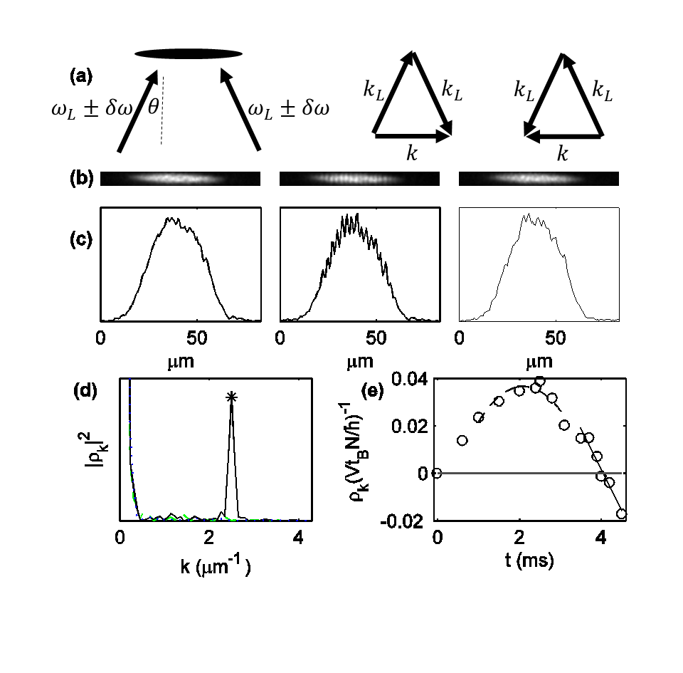
Vacuum fluctuations
BEC with phonons (not vacuum)
I. Shammass, S. Rinott, A. Berkovitz, R. Schley, and JS, PRL 109, 195301 (2012).
BEC without phonons (vacuum)

Slide 14
Vacuum fluctuations
BEC with phonons (not vacuum)
I. Shammass, S. Rinott, A. Berkovitz, R. Schley, and JS, PRL 109, 195301 (2012).
BEC without phonons (vacuum)
pointlike atoms

Slide 15
Vacuum fluctuations
BEC with phonons (not vacuum)
I. Shammass, S. Rinott, A. Berkovitz, R. Schley, and JS, PRL 109, 195301 (2012).
BEC without phonons (vacuum)
pointlike atoms

Slide 16
Vacuum fluctuations
BEC with phonons (not vacuum)
I. Shammass, S. Rinott, A. Berkovitz, R. Schley, and JS, PRL 109, 195301 (2012).
BEC without phonons (vacuum)
pointlike atoms

Slide 17
Hawking radiation
Creation of the pairs by the quantum vacuum fluctuations
sonic horizon
Subsonic flow
Supersonic flow
Comoving frame
Lab frame
$$ℏω>0$$
$$ℏω<0$$
$$E_{pair}=0$$
Jeff Steinhauer, Nature Physics 12, 959 (2016).

Slide 18



Correlation function
Balbinot, R., Fabbri, A., Fagnocchi, S., Recati, A. & Carusotto, I. Phys. Rev. A 78, 021603(R) (2008).
$$G^{\left(2\right)}\left(x,x′\right)={\sqrt{n_{out}n_{in}ξ_{out}ξ_{in}}〈δn\left(x\right)δn\left(x′\right)〉}/{n_{out}n_{in}}$$
This is how we observe Hawking radiation
$$x$$
$$x′$$

Slide 19
Experimental Technique
step: 442 nm, NA 0.5
Lahav, O., Itah, A., Blumkin, A., Gordon, C., Rinott, S., Zayats, A. & Steinhauer, J. Phys. Rev. Lett. 105, 240401 (2010).

Slide 20
Experimental Technique
step: 442 nm, NA 0.5

Slide 21
Experimental Technique
step: 442 nm, NA 0.5
Imaging: 780 nm, NA 0.5

Slide 22
Experimental Technique
step: 442 nm, NA 0.5
trapping: 812 nm
Imaging: 780 nm, NA 0.5

Slide 23
Experimental Technique
step: 442 nm, NA 0.5
trapping: 812 nm
B-field gradient
Imaging: 780 nm, NA 0.5

Slide 24
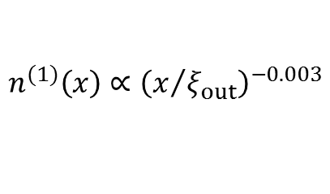








Experimental Technique
$$v_{out}=0.24 mm \sec^{−1}$$
$$c_{out}=0.57 mm \sec^{−1}$$
$$ξ_{out}=1.3 μm$$
$$\frac{mc_{out}^{2}}{h}=70 Hz$$
$$\frac{ω_{trap}}{2π}=140 Hz$$
$$v_{in}=1.02 mm \sec^{−1}$$
$$c_{in}=0.25 mm \sec^{−1}$$
$$ξ_{in}=3.0 μm$$
$$\frac{mc_{in}^{2}}{h}=13 Hz$$
$$n_{out}ξ_{out}=62$$
$$n_{in}ξ_{in}=27$$
$$n^{(1)}\left(x\right)∝{\left(x/ξ\right)}^{−\frac{1}{2πnξ}}$$
$$n^{(1)}\left(x\right)∝{\left(x/{ξ_{out}}\right)}^{−0.003}$$
$$n^{(1)}\left(x\right)∝{\left(x/{ξ_{in}}\right)}^{−0.006}$$
$$n^{(1)}\left(L\right)∝0.99$$
$$n^{(1)}\left(L\right)∝0.99$$
Jeff Steinhauer, Nature Physics 12, 959 (2016).
Larré, P.-É., Recati, A., Carusotto, I. & Pavloff, N.
Phys. Rev. A 85, 013621 (2012).

Slide 25
Experimental Technique
$$v_{out}=0.24 mm \sec^{−1}$$
$$c_{out}=0.57 mm \sec^{−1}$$
$$ξ_{out}=1.3 μm$$
$$\frac{mc_{out}^{2}}{h}=70 Hz$$
$$\frac{ω_{trap}}{2π}=140 Hz$$
$$v_{in}=1.02 mm \sec^{−1}$$
$$c_{in}=0.25 mm \sec^{−1}$$
$$ξ_{in}=3.0 μm$$
$$\frac{mc_{in}^{2}}{h}=13 Hz$$
Hawking radiation
Oscillating horizon experiment
  1 micron amplitude
  Various frequencies
Jeff Steinhauer, Nature Physics 12, 959 (2016).

Slide 26



Oscillating horizon experiment
$$ω_{peak}/2$$
$$ω_{peak}$$
$$S_{0}^{4}{\left|β\right|}^{2}\left({\left|β\right|}^{2}+1\right)$$
simulation

Slide 27
Experimental Technique
$$v_{out}=0.24 mm \sec^{−1}$$
$$c_{out}=0.57 mm \sec^{−1}$$
$$ξ_{out}=1.3 μm$$
$$\frac{mc_{out}^{2}}{h}=70 Hz$$
$$\frac{ω_{trap}}{2π}=140 Hz$$
$$v_{in}=1.02 mm \sec^{−1}$$
$$c_{in}=0.25 mm \sec^{−1}$$
$$ξ_{in}=3.0 μm$$
$$\frac{mc_{in}^{2}}{h}=13 Hz$$
Hawking radiation
Oscillating horizon experiment
  1 micron amplitude
  Various frequencies
Jeff Steinhauer, Nature Physics 12, 959 (2016).

Slide 28
Observation of Hawking radiation
(in, out)
Correlations between Hawking and partner particles
Ensemble of 4600 images
Jeff Steinhauer, Nature Physics 12, 959 (2016).

Slide 29
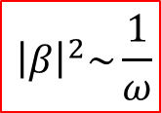



Observation of Hawking radiation
Correlations between Hawking and partner particles
$$S_{0}〈{\hat{b}}_{k_{HR}}^{}{\hat{b}}_{k_{P}}^{}〉=\sqrt{−tanθ−cotθ}\int{dx′′e^{ikx′′}G^{\left(2\right)}\left(x,x′\right)}$$
$$\sim ω$$
$$\sim {\left|β\right|}^{2}$$
finite value
$${\left|β\right|}^{2}\sim \frac{1}{ω}$$
Thermal distribution
Jeff Steinhauer, Nature Physics 12, 959 (2016).

Slide 30
Observation of Hawking radiation
Experiment Simulation
Jeff Steinhauer, Nature Physics 12, 959 (2016).

Slide 31
Measuring the population of Hawking particles
$$S\left(k\right)=〈ρ_{k_{HR}}^{out}ρ_{−k_{HR}}^{out}〉=N_{out}{\left(U_{k_{HR}}+V_{k_{HR}}\right)}^{2}\left(〈{\hat{b}}_{k_{HR}}^{ †}{\hat{b}}_{k_{HR}}^{}〉+1\right)$$
Schley, R., Berkovitz, A., Rinott, S., Shammass, I., Blumkin, A. & Steinhauer, J. Phys. Rev. Lett. 111, 055301 (2013).

Slide 32

Measured population of Hawking particles
unity: pointlike particles
$${k_{B}T}_{H}=0.36 mc_{out}^{2}$$
(1.2 nK)
2.7 nK
Quantum fluctuations
1.2 nK
$$S\left(k\right)=〈ρ_{k_{HR}}^{out}ρ_{−k_{HR}}^{out}〉=N_{out}{\left(U_{k_{HR}}+V_{k_{HR}}\right)}^{2}\left(〈{\hat{b}}_{k_{HR}}^{ †}{\hat{b}}_{k_{HR}}^{}〉+1\right)$$
Jeff Steinhauer, Nature Physics 12, 959 (2016).

Slide 33




Measuring entanglement of Hawking radiation
$$G^{\left(2\right)}\left(x,x′\right)={\sqrt{n_{out}n_{in}ξ_{out}ξ_{in}}〈δn\left(x\right)δn\left(x′\right)〉}/{n_{out}n_{in}}$$
Steinhauer, J. PRD 92, 024043 (2015).
$$S_{0}〈{\hat{b}}_{k_{HR}}^{}{\hat{b}}_{k_{P}}^{}〉=\sqrt{−tanθ−cotθ}\int{dx′′e^{ikx′′}G^{\left(2\right)}\left(x,x′\right)}$$
$$S_{0}≡\left(U_{k_{HR}}+V_{k_{HR}}\right)\left(U_{k_{P}}+V_{k_{P}}\right)$$
Busch, X. & Parentani, R. PRD 89, 105024 (2014).
$$Δ≡〈{\hat{b}}_{k_{HR}}^{ †}{\hat{b}}_{k_{HR}}^{}〉〈{\hat{b}}_{k_{P}}^{ †}{\hat{b}}_{k_{P}}^{}〉−{\left|〈{\hat{b}}_{k_{HR}}^{}{\hat{b}}_{k_{P}}^{}〉\right|}^{2}$$
nonseparability criterion

Slide 34





Assumption, noncommuting observables
We m$easure 〈{\hat{b}}_{k_{HR}}^{}{\hat{b}}_{k_{P}}^{}〉+〈{\hat{b}}_{{−k}_{HR}}^{†}{\hat{b}}_{{−k}_{P}}^{†}〉+〈{\hat{b}}_{{−k}_{HR}}^{†}{\hat{b}}_{k_{P}}^{}〉+〈{\hat{b}}_{{−k}_{P}}^{†}{\hat{b}}_{k_{HR}}^{}〉$.
We neglect these terms.
We can neglect them because:
They are correlations between waves of different frequencies.
  The frequencies of the negative k’s are Doppler shifted by $2\left|k_{i}\right|v_{i}$ relative to the positive k’s.
The modes are widely separated in space.
This is valid in an inhomogeneous, flowing condensate.
$$Δ≡〈{\hat{b}}_{k_{HR}}^{ †}{\hat{b}}_{k_{HR}}^{}〉〈{\hat{b}}_{k_{P}}^{ †}{\hat{b}}_{k_{P}}^{}〉−{\left|〈{\hat{b}}_{k_{HR}}^{}{\hat{b}}_{k_{P}}^{}〉\right|}^{2}$$
Noncommuting observables
We measure $〈{\hat{b}}_{k_{HR}}^{}{\hat{b}}_{k_{P}}^{}〉$ within the reasonable assumption that we can neglect the 3 terms. This quantity does not commute with the population measurement.
$$k_{HR}$$
$$−k_{HR}$$
$$k_{P}$$

Slide 35







Hydrodynamic approximation
$$S_{0}〈{\hat{b}}_{k_{HR}}^{}{\hat{b}}_{k_{P}}^{}〉=\sqrt{−tanθ−cotθ}\int{dx′′e^{ikx′′}G^{\left(2\right)}\left(x,x′\right)}$$
$${\left|〈{\hat{b}}_{k_{HR}}^{}{\hat{b}}_{k_{P}}^{}〉\right|}^{2}={\left|α\right|}^{2}{\left|β\right|}^{2}$$
✓
$$Δ≡〈{\hat{b}}_{k_{HR}}^{ †}{\hat{b}}_{k_{HR}}^{}〉〈{\hat{b}}_{k_{P}}^{ †}{\hat{b}}_{k_{P}}^{}〉−{\left|〈{\hat{b}}_{k_{HR}}^{}{\hat{b}}_{k_{P}}^{}〉\right|}^{2}$$
Heisenberg limit
$${\left|〈{\hat{b}}_{k_{HR}}^{}{\hat{b}}_{k_{P}}^{}〉\right|}^{2}≤\left({\left|β\right|}^{2}+1\right){\left|β\right|}^{2}$$
Entanglement at all frequencies
Busch, X. & Parentani, R. PRD 89, 105024 (2014).
$${\hat{b}}_{k_{HR}}^{}=α{\hat{b}}_{in+}^{}+β^{∗}{\hat{b}}_{in−}^{†}$$
$${\hat{b}}_{k_{P}}^{}=β^{∗}{\hat{b}}_{in+}^{†}+α{\hat{b}}_{in−}^{}$$
Maximal entanglement at all frequencies
$${\left|β\right|}^{2}=\frac{1}{e^{ℏω/k_{B}T_{H}}−1}$$
$${\left|α\right|}^{2}={\left|β\right|}^{2}+1$$

Slide 36


Measuring entanglement between the Hawking pairs
$$Δ≡〈{\hat{b}}_{k_{HR}}^{ †}{\hat{b}}_{k_{HR}}^{}〉〈{\hat{b}}_{k_{P}}^{ †}{\hat{b}}_{k_{P}}^{}〉−{\left|〈{\hat{b}}_{k_{HR}}^{}{\hat{b}}_{k_{P}}^{}〉\right|}^{2}$$
$$S_{0}〈{\hat{b}}_{k_{HR}}^{}{\hat{b}}_{k_{P}}^{}〉=\sqrt{−tanθ−cotθ}\int{dx′′e^{ikx′′}G^{\left(2\right)}\left(x,x′\right)}$$
Jeff Steinhauer, Nature Physics 12, 959 (2016).

Slide 37

Measuring entanglement between the Hawking pairs
simulation
$$Δ≡〈{\hat{b}}_{k_{HR}}^{ †}{\hat{b}}_{k_{HR}}^{}〉〈{\hat{b}}_{k_{P}}^{ †}{\hat{b}}_{k_{P}}^{}〉−{\left|〈{\hat{b}}_{k_{HR}}^{}{\hat{b}}_{k_{P}}^{}〉\right|}^{2}$$
Jeff Steinhauer, Nature Physics 12, 959 (2016).

Slide 38
Measuring entanglement between the Hawking pairs
Gray curve: maximally entangled H$eisenberg limit S_{0}^{2}{\left|β\right|}^{2}\left({\left|β\right|}^{2}+1\right)$
simulation
$$Δ≡〈{\hat{b}}_{k_{HR}}^{ †}{\hat{b}}_{k_{HR}}^{}〉〈{\hat{b}}_{k_{P}}^{ †}{\hat{b}}_{k_{P}}^{}〉−{\left|〈{\hat{b}}_{k_{HR}}^{}{\hat{b}}_{k_{P}}^{}〉\right|}^{2}$$
Jeff Steinhauer, Nature Physics 12, 959 (2016).

Slide 39
Statistical analysis
2.7 nK
1.2 nK
2.7 nK
1.2 nK

Slide 40
Statistical analysis
1.2 nK
2.7 nK
16%
Narrower by a factor of 1/1.9
wider by 90%
Entanglement confirmed with a significance of 5.7σ

Slide 41
Conclusions
Quantum Hawking radiation is observed.
The Hawking radiation is observed through the correlations between the Hawking and partner particles.
The quantum nature of the Hawking radiation is verified by observing the entanglement.
The experiment is well within the quantum regime (1.2 nK < 2.7 nK).
The measurement shows maximal entanglement at high energies, no entanglement at the lowest energies.
1/ω thermal behavior is seen at very low energies, Planckian thermal behavior is seen at high energies.
The oscillating horizon experiment verifies
  the Hawking temperature
  the ratio of the Hawking/partner phase velocities
  the width of the Hawking/partner correlation feature
The simulation verifies
  the approximately stationary background
  the width of the Hawking/partner correlation feature

Slide 42
Implications for real gravity
Black hole thermodynamics is “verified” experimentally.
  An analogue black hole does radiate.
  Hawking’s calculation is confirmed.
The Hawking/partner pairs are entangled.
  Confirms an important element in the discussion of information loss.
  Limits the outgoing information.

